Slide 1
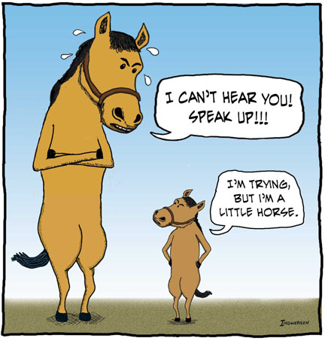

Using Humor Responsibly
Creating Safety Through Thoughtful Comedy
"Humor can be a bridge to learning or a barrier”

Slide 2

Humor as a Nervous System Trainer
Why Does Humor Matter in Training?
Releases tension: Laughter activates the parasympathetic nervous system
Creates connection: Shared laughter builds social bonds
Reduces cortisol: Natural stress hormone regulation
Increases learning: A Relaxed nervous system absorbs information better
Builds resilience: Finding lightness in difficult topics
"When we laugh together, our nervous systems co-regulate toward safety and connection."

Slide 3

Using Humor Responsibly
Can Harm When It:
Humor Harms When It:
Minimizes trauma or pain
Creates shame or embarrassment
Excludes or marginalizes
Deflects from necessary processing
Reinforces power imbalances
Humor Heals When It:
Creates inclusive connection
Validates shared experiences
Provides gentle perspective
Builds community and belonging
Supports nervous system regulation

Slide 4



Identify Participant’s Nervous System State
Humor Reception Varies by State:
Ventral Vagal
Receptive to humor
Can laugh at themselves
Enjoys playful learning
Sympathetic (Activated)
May misinterpret humor
Heightened sensitivity
Needs a gentle approach
Dorsal Vagal (Shutdown)
Humor may not register
Focus on connection first
Use sparingly, if at all

Slide 5

Trauma-Informed Humor
“Will this create safety and connection, or will it cause harm?'"
Safety First:
Never compromise emotional or physical safety for a laugh
Choice and Control:
Let people opt-in to humor, don't force participation
Cultural Humility:
Understand that humor varies across cultures and experiences
Power Dynamics:
Be especially careful when you hold authority or expertise
Timing Matters:
Read the room and the moment
Intent vs. Impact:
Good intentions don't negate harmful impact

Slide 6

The Direction of Humor Matters
Lower Risk (Generally)
Self-deprecating: "I once spent 20 minutes looking for my phone while talking on it.”
Universal experiences: "We've all had that moment when...”
Gentle observations: About situations, not people
Inclusive humor: Everyone can relate and participate
Higher Risk
Other-deprecating: Making fun of students/participants
Identity-based humor: About protected characteristics
Trauma-based jokes: Making light of serious pain
Exclusive humor: Inside jokes that isolate others

Slide 7


Signs Humor is Landing Well:
Genuine laughter and smiles
Relaxed body language
Increased participation and engagement
People are building on the humor together
Stop and Adjust:
Uncomfortable silence or forced laughter
Crossed arms, closed body language
People checking out or dissociating
Nervous energy increasing rather than decreasing
Anyone looking hurt, confused, or angry

Slide 8
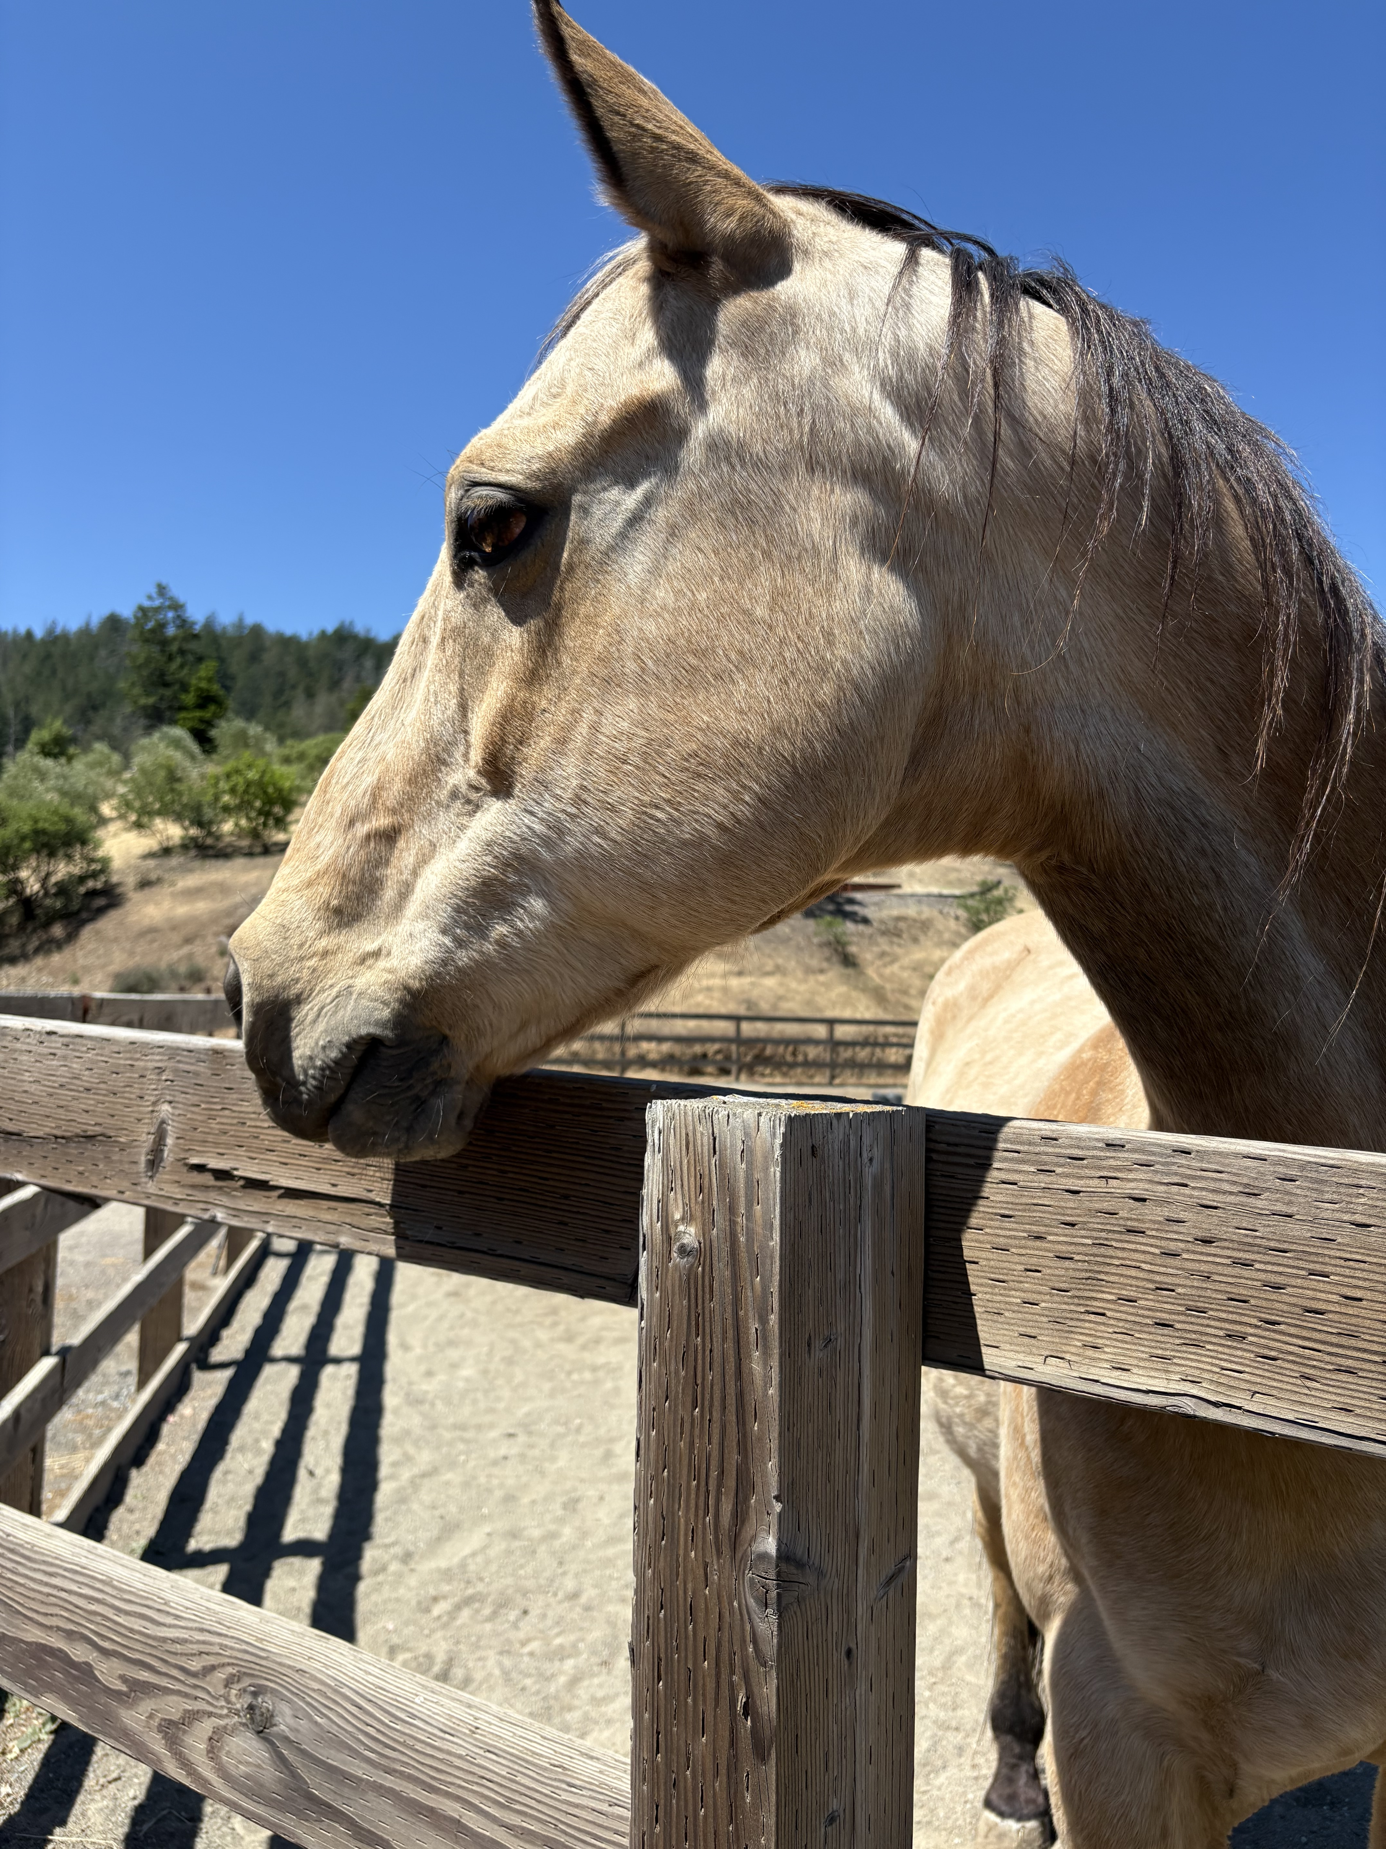
Equine Context: Special Considerations
Horses sense your nervous system: Your laughter needs to be genuine not forced
Safety is paramount: Never joke about safety protocols or procedures
Respect the horse: Avoid humor that makes the horse the "butt of the joke"
Model regulation: Use humor to demonstrate calm, regulated states
Cultural sensitivity: Horse communities have diverse backgrounds and Experiences
Fear is real: Never minimize someone's genuine fear of horses
"Horses don't understand our words, but they absolutely understand our energy. Make sure your humor creates the energy you want them to feel."

Slide 9

Timing and Context Are Everything
Good Times for Humor:
Ice breakers: When building initial rapport
Transition moments: Moving between serious topics
After success: Celebrating achievements together
Teaching moments: Making concepts memorable
Closing activities: Ending on a positive note
Proceed with Caution:
During emotional processing or breakthroughs
When someone is sharing trauma or pain
During moments of high activation or dysregulation
When establishing boundaries or addressing harm
In crisis or emergency situations

Slide 10

When Humor Goes Wrong:
Recovery and Repair
Steps for Repair
Stop immediately: Don't double down or make excuses
Acknowledge the impact: "I see that landed wrong"
Take responsibility: "That was my mistake"
Make amends: "How can I make this right?"
Learn and adjust: Change your approach going forward
What NOT to Do
Be dismissive: "I was just joking"
Blame-shift: "You're too sensitive"
Give over impact: "That's not what I meant"
Continuing with more humor to "fix" it

Slide 11

Developing Your Humor Skills
Observational humor: Gentle, relatable observations
Storytelling: Amusing anecdotes from your experience
Wordplay: Puns and linguistic playfulness
Physical comedy: Safe, appropriate gestures and expressions
Timing: Pause, delivery, and reading reactions
Things to Avoid:
Sarcasm: Can feel cutting or mean
Shock humor: Relies on surprise or discomfort
Stereotype-based: Reinforces harmful biases
Self-harm humor: Joking about serious personal struggles
Divisive topics: Politics, religion, and controversial subjects

Slide 12

Humor and Psychological Safety
How Responsible Humor Builds Safety
Normalizes imperfection: "We all make mistakes and that's okay"
Creates shared humanity: "We're all figuring this out together"
Reduces hierarchy: "I'm human too, with flaws and funny moments"
Encourages vulnerability: "It's safe to be real here"
Builds resilience: "We can find lightness even in difficult moments”
"Psychological safety isn't the absence of challenge – it's the presence of support, and humor can be a powerful form of support when used wisely."

Slide 13

Practical Guidelines
Before Using Humor, Ask Yourself:
What nervous system state is my audience in right now?
Will this create a connection or division?
Am I punching up (at those with more power) or down (at the vulnerable)?
Is this serving the learning objectives or just my ego?
How will this land for someone having a hard day?
Can I achieve the same goal without humor if needed?
Golden Rule:
"When in doubt, choose connection over comedy."

Slide 14
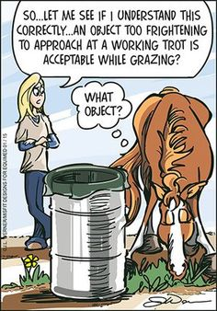
Responsible Humor
Key Principles to Remember:
Safety first, always
Connection over comedy
Listen to impact, not just intent
Consider nervous system states
Inclusive, not exclusive
Timing and context matter
Be ready to repair and adjust
"The goal isn't to avoid humor - it's to use it skillfully as a tool for healing, connection, and growth.”
When we use humor responsibly, we create spaces where everyone can laugh, learn, and feel truly safe to be themselves

Slide 15
